Slide 1


Slide 2


Mixed martial arts (MMA) is a full-contact combat sport that allows a wide variety of fighting techniques and skills from a mixture of other combat sports to be used in competition. The rules allow usage of both striking and grappling techniques while standing and on the ground. Competitions allow athletes of different disciplines of martial arts to compete under a set of unified rules.
The Ultimate Fighting Championship (UFC) is an mixed martial arts organization based in Las Vegas, US. Based in the United States, the UFC produces events worldwide that showcase 12 weight divisions and abides by the Unified Rules of Mixed Martial Arts

Slide 3
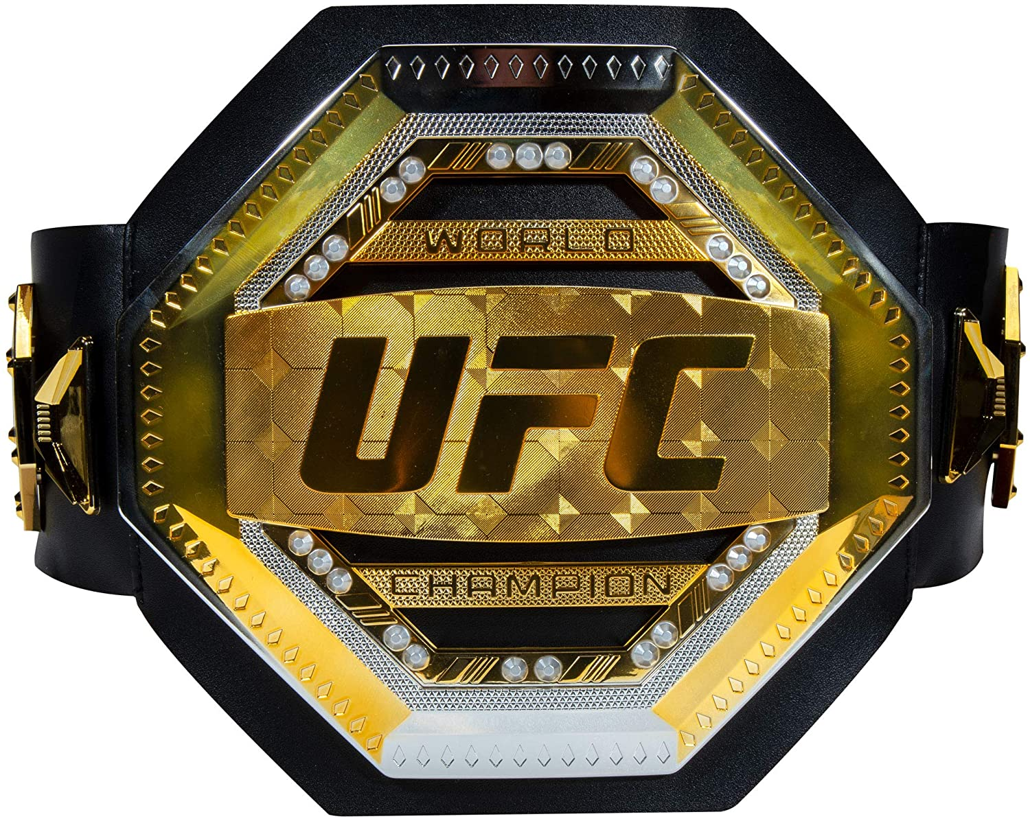
HOW TO WIN
Technical Knockout (TKO): The referee stops the contest due to strikes or impact.
Submission (SUB): Physical or verbal tap out by one of dozens of methods of submission.
Judges' Decision: When a fight is not finished by a submission, KO, or TKO, the judges deliver their scorecards for a final decision.
Knockout (KO): Athlete is knocked unconscious due to strikes or impact.
Notes:
Unanimous decision win: All three judges have the same fighter as the winner.
Majority decision win: Two judges have one fighter winning the fight and the third judge scores it a draw.
Split decision win: Two judges have one fighter winning the fight and the third judge has the other fighter winning it.
Unanimous draw: All three judges score it a draw.
Majority draw: Two judges score it a draw, and the third judge has a winner.
Split draw: One judge scores it a draw, and the other two judges have different winners.

Slide 4
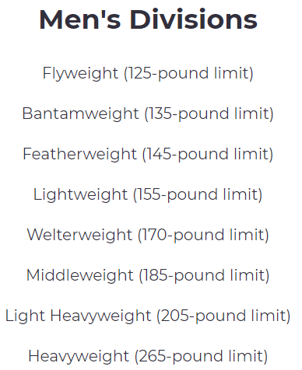
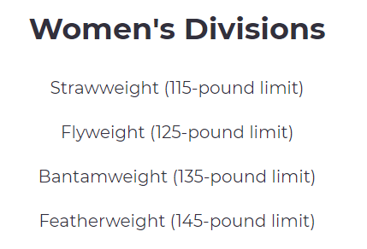
WEIGHT CLASSES

Slide 5
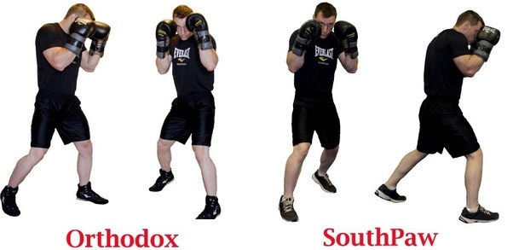
Common stances

Slide 6

Common statistics

Slide 7
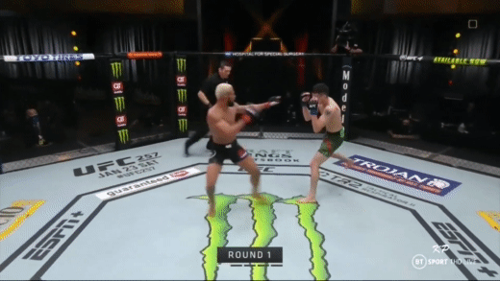
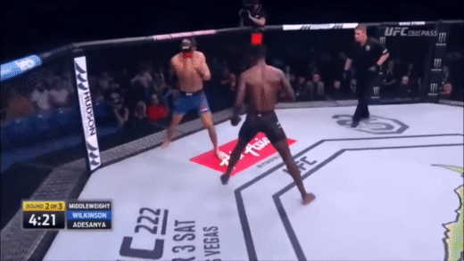
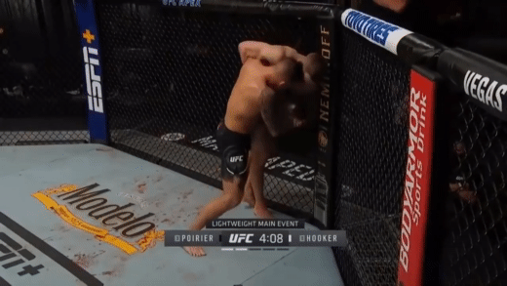
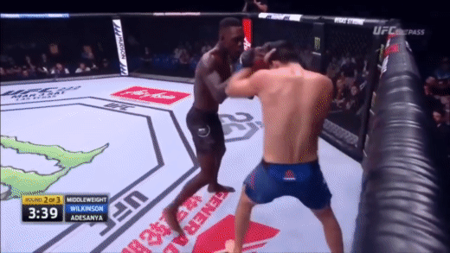
Common statistics
Significant Strike (SIG_STR)
Head
Clinch
Body

Slide 8
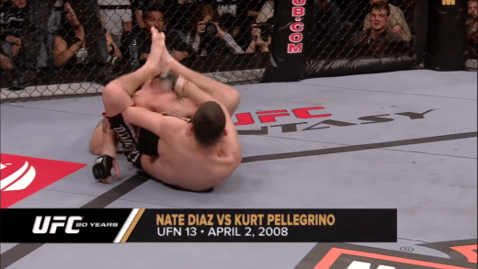
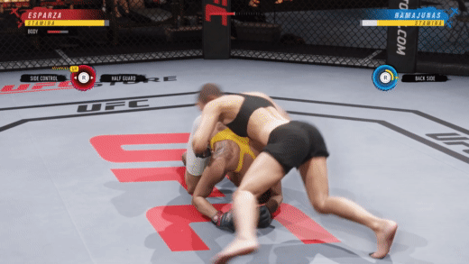
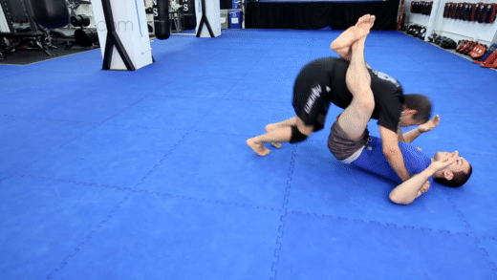
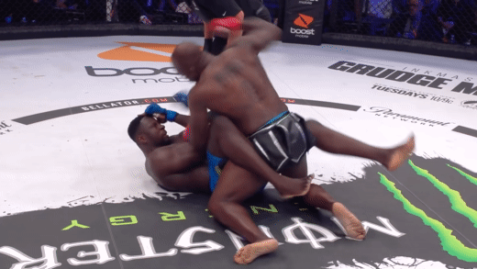
Common statistics
Submission (SUB)
Reversals (Rev)
Pass
Ground

Slide 9
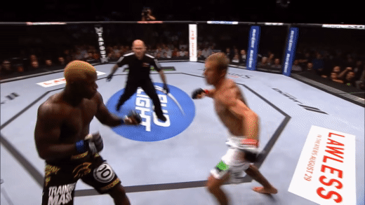
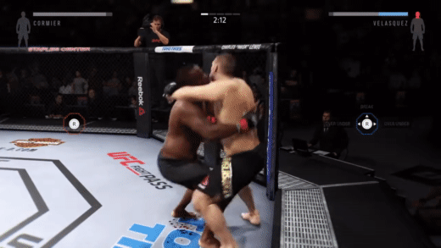
Common statistics
Knockdown (KD)
Takedown (TD)
Notes:
If anything other than the soles of their feet touches the ground after getting struck, it is considered a knockdown
a takedown is a technique that involves off-balancing an opponent and bringing him or her to the ground with the attacker landing on top

